Slide 1
Marine Debris
Classification
DEEP LEARNING · GROUP G10
One network that looks at the sea from four viewpoints (underwater, shore, drone and satellite) and tells what debris it sees.
Adham Yakout
Adham Elbehiry
Asma Raafat
Hamza
ID 231000914
ID 231000593
ID 241011502
ID 231006758
Notes:
Welcome. We are group G10. Our project: one deep network that classifies marine debris from four very different camera viewpoints. The talk follows the order we actually worked in: the design, the data, the code, every problem we hit in training and the fix each led to, and finally the results and our verdict.

Slide 2
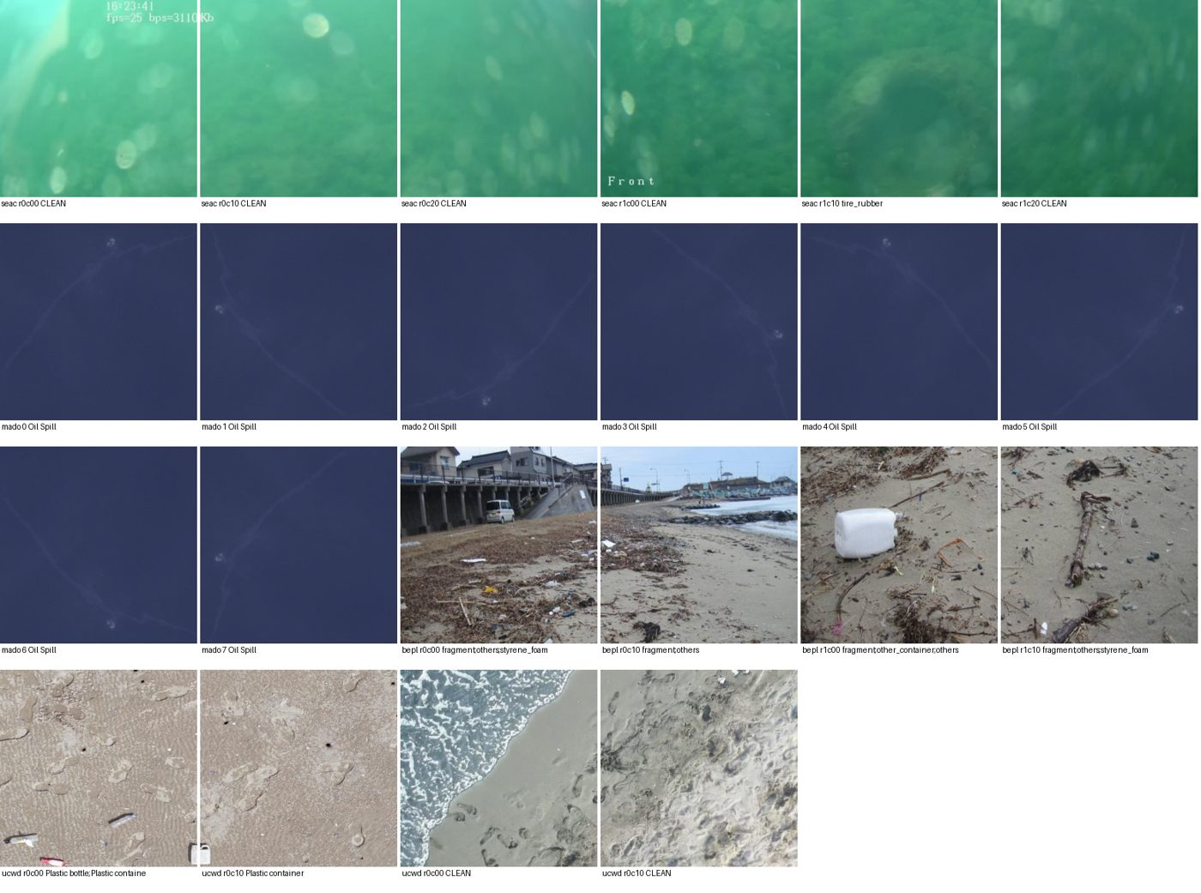
Debris is monitored from four very different viewpoints
THE PROBLEM
Divers and robots film the seabed, volunteers photograph beaches, drones survey coastlines and satellites scan the open sea. Each source looks completely different, and most published models handle only one.
Our idea: one network for all four
For any sea photo it answers three questions: which viewpoint is this, is there trash, and which kinds of debris are in it.
G10 · Marine Debris Classification · 2
Notes:
The motivation: debris is studied underwater, on beaches, from drones and from satellites, and these images share almost nothing visually. Most work picks one source. Our idea was a single model that handles all four and answers three questions per photo: the viewpoint, whether there is trash, and which debris types. The image shows real samples from our four datasets.

Slide 3
Recent work is strong, but each paper stays in one domain
RELATED WORK, 2024–2026
Work | Domain | What it shows
Đuraš et al., Sci. Data 2024 | Underwater | SeaClear: 8,610 seabed images (our underwater data)
He et al., preprint 2025 | Underwater | YOLOv11 on SeaClear: mAP@0.5 66.9% → 77.3%
Kikaki et al., ISPRS J. 2024 | Satellite | MADOS: Sentinel-2 pollutants (our satellite data)
Manesis et al., ISPRS Annals 2026 | Satellite | MADOS labels moved to radar for segmentation
Jack et al., Remote Sensing 2025 | Drone | Drone debris detection drops past ~3 cm/pixel
Kataria, arXiv 2025 | Underwater | MobileNetV2 most robust to domain shift
The gap we target: one classifier across underwater, shore, drone and satellite, with a fair baseline vs transfer-learning comparison.
G10 · Marine Debris Classification · 3
Notes:
Recent literature. SeaClear and MADOS are the dataset papers behind two of our four datasets. He et al. push detection on SeaClear with YOLOv11. Manesis et al. 2026 extend MADOS to radar. Jack et al. 2025 study drone debris detection and resolution limits. Kataria 2025 is interesting for us: a lightweight MobileNetV2 generalized best under domain shift. The common thread: each paper works in one domain. Our contribution is a single multi-domain classifier and a controlled comparison of a scratch CNN against transfer learning. Full references are on the last slide.

Slide 4
The design
PART 1
Before writing any code, we drew the network on paper and argued every block into place.
Notes:
Part one: the design. We spent the first days deciding the architecture on paper before touching code, and every block had to answer a concrete problem.

Slide 5
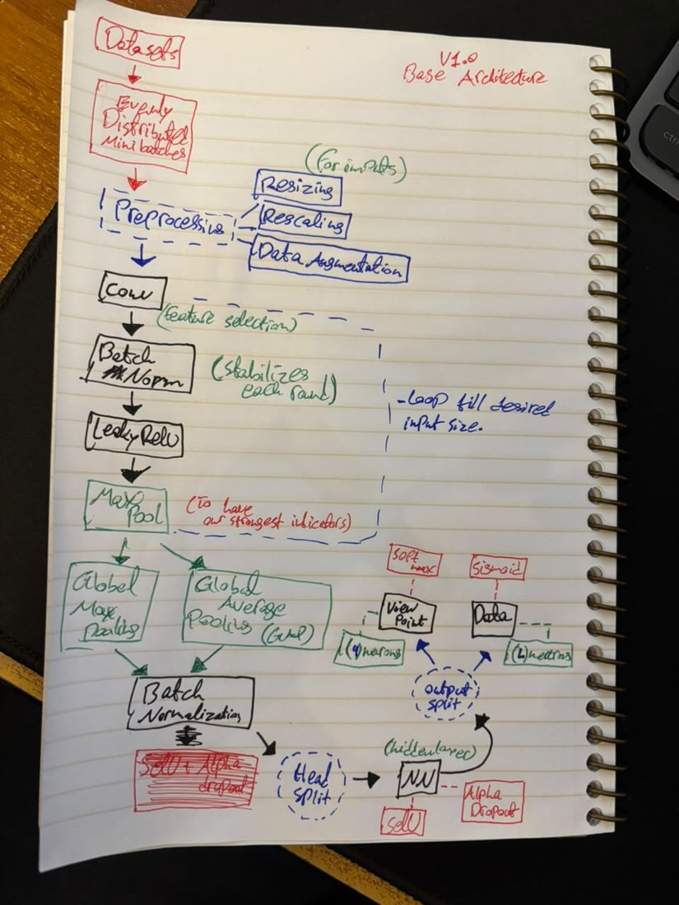
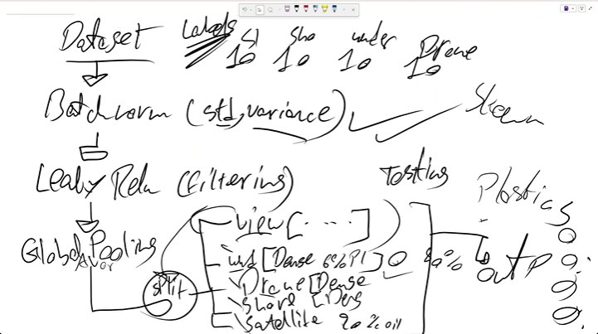
It started as a sketch, and the final model is still that sketch
THE DESIGN · WHERE IT STARTED
Left: balanced mini-batches, preprocessing, a convolution block repeated to size, two global poolings, then a split into a softmax viewpoint output and sigmoid dataset outputs. Right: the same split into five heads.
G10 · Marine Debris Classification · 5
Notes:
These are our real first drafts. The notebook page is version 1.0 of the architecture: evenly distributed mini-batches, preprocessing with resizing, rescaling and augmentation, a Conv, BatchNorm, LeakyReLU, MaxPool block looped until the feature map is small enough, global max and global average pooling, BatchNorm, then SELU layers with AlphaDropout and a split into a softmax viewpoint output and sigmoid dataset outputs. The whiteboard shows the split into five heads. The final model kept this structure; what changed were sizes and details, driven by evidence.

Slide 6

One shared backbone, five heads, one trash neuron per head
THE DESIGN · ARCHITECTURE
Viewpoint
softmax · 4
Backbone
Baseline CNN: 4 × Conv → BatchNorm → LeakyReLU → MaxPool
Underwater
sigmoid · 16 + trash
Image
Pooling
320 × 320 tile, scaled to −1…+1
Global average + global max → BatchNorm
Shore
sigmoid · 13 + trash
Transfer: MobileNetV2, ImageNet weights
Drone
sigmoid · 7 + trash
Satellite
sigmoid · 7 + pollution
Both models share everything after the backbone, so the comparison changes exactly one thing. 47 class outputs + 4 trash neurons = 51 outputs.
G10 · Marine Debris Classification · 6
Notes:
The final architecture. A 320 by 320 tile goes into a backbone: either our own four-block CNN or MobileNetV2 pretrained on ImageNet. Global average and global max pooling are concatenated and normalized, then five heads branch off: a softmax viewpoint head with four outputs, and four sigmoid heads, one per dataset, each with an extra trash-present neuron. For satellite, the extra neuron means pollution: marine debris or oil spill. Because everything after the backbone is identical, the baseline versus transfer comparison isolates the backbone.

Slide 7
Every block answers a concrete problem
THE DESIGN · CHOICES
Sigmoid, not softmax
Loss masking
Focal loss
A tile can hold a bottle and a rope. Softmax forces one answer; sigmoid gives each class its own yes/no.
An underwater photo has no shore labels. Each image trains only the viewpoint head and its own head.
Most tiles are clean and classes are rare. Focal loss (γ = 2) stops the model learning "always no".
Average + max pooling
SELU + AlphaDropout
AdamW, batch 32 → 96
Satellite debris can be a few pixels. Averaging washes it out; the max keeps the brightest signal.
Self-normalizing dense heads stay stable without extra BatchNorm layers in every head.
Adaptive steps for uneven data; small noisy batches for 3 epochs, then large stable ones.
G10 · Marine Debris Classification · 7
Notes:
Each design choice came from a problem. Sigmoid outputs because a tile can contain several debris types. Loss masking because an underwater image says nothing about shore classes, so only its own head learns from it. Focal loss because clean tiles dominate and plain cross-entropy would learn to always say no. Average plus max pooling because tiny satellite debris disappears when averaged. SELU with AlphaDropout for stable dense heads. And AdamW with a batch-size warm-up: 32 for three epochs, then 96, following Smith et al. 2018.

Slide 8
Each head is sized by how much it has to learn from
THE DESIGN · HEAD SIZES
Shore
512 → 256 → 128
THE IDEA
More data, bigger head
Underwater
384 → 192 → 96
Drone
256 → 128
Shore has the most labels, so it gets the biggest head. Underwater has about half as many and satellite very few, so theirs are smaller. Drone already worked well, so we left it as it was. Each layer is half the one before.
Satellite
128 → 64
Viewpoint
128
Training labels | Shore | Underwater | Satellite
one per class per tile | 28,123 | 15,575 | 1,053
G10 · Marine Debris Classification · 8
Notes:
How big should each head be? The idea is simple: the more a head has to learn from, the bigger it can be without memorising. Shore has the most training labels, about 28 thousand, so it gets the biggest head, 512 neurons. Underwater has about half that, so 384. Satellite has only about a thousand, so it gets the smallest, 128. Drone already worked well, so we left it unchanged. Each layer is half the size of the one before.

Slide 9
Every batch is a fair mix of all four datasets
THE DESIGN · FEEDING THE NETWORK
One batch of 96 tiles
Underwater 26
Shore 26
Drone 23
Satellite 21
Shares follow the square root of each dataset's pool: big datasets don't drown small ones, small ones aren't over-repeated.
20%
×8
32 → 96
clean tiles, re-drawn every epoch, so the model sees trash often but still learns what "clean" looks like
orientations for each satellite patch (rotations and flips): satellite images have no "up"
batch size: small and noisy for the first 3 epochs, then large and stable
G10 · Marine Debris Classification · 9
Notes:
How data reaches the network. Every batch of 96 deals a fixed number of tiles from each dataset, using square-root balancing: 26 underwater, 26 shore, 23 drone, 21 satellite. Clean tiles are sampled down to 20 percent and re-drawn every epoch. Satellite patches get eight orientations, since there is no up in a satellite image. And the batch size starts at 32 for three epochs, then rises to 96.

Slide 10
The data
PART 2
A design is only as good as what it learns from. Four datasets, one per viewpoint, and the work of making them fit together.
Notes:
Part two: the data. This is where most of our real progress came from, and where the biggest bug turned out to be.

Slide 11
One public dataset per viewpoint, each chosen for a reason
THE DATA · FOUR DATASETS
UNDERWATER
SHORE
DRONE
SATELLITE
SeaClear
BePLi v2
UCWD
MADOS
8,610 seabed photos from robots and divers, outlined objects, 16 classes after merging
3,722 beach photos, 13 plastic classes, from fragments to buoys and nets
3,169 coastal drone images kept (of 4,071), 7 waste classes
2,803 Sentinel-2 patches, 7 classes: debris, oil spill, ships, platforms, algae and more
Why: sea coast, unlike the lake set we tried first
Why: real murky footage, precise object outlines
Why: the richest annotated beach-plastic set
Why: separates debris from its look-alikes
Together: 43 debris classes across four domains. All four were built for detection (boxes or pixel masks), so we had to turn them into classification data ourselves.
G10 · Marine Debris Classification · 11
Notes:
Our dataset justification. SeaClear for underwater: real robot and diver footage with precise outlines. BePLi v2 for shore: the richest annotated beach plastic set. UCWD for drone: coastal imagery; we first tried a lake dataset and replaced it. MADOS for satellite: it labels debris separately from look-alikes like algae, foam and ships, which is exactly what a satellite debris classifier must tell apart. Together, 43 debris classes. The catch: all four were built for detection, so converting them to classification was our job, and that conversion matters later in the story.

Slide 12

From detection photos to labelled tiles, without leaks
THE DATA · PREPARATION
1
2
3
4
Merge classes
Cut into tiles
Label each tile
Split by video
Rare classes grouped by meaning (rope fibre + rope plastic → rope). Animals, plants, robot parts set aside as "not trash".
Underwater 3×2, shore 3×3, drone ~640 px, satellite whole. Small objects stay visible at 320 px.
An object counts for a tile if enough of it is inside. This rule comes back later.
Frames of one video never land in both training and test, so scores can't be inflated by near-copies.
≈123k
≈25k + 25k
320 px
training tiles
validation and test tiles, originals only
input size, saved at 352 for cropping
G10 · Marine Debris Classification · 12
Notes:
Preparing the data took four steps. One: merge rare classes by meaning and set aside animals, plants and robot parts as not trash. Two: cut photos into tiles so small objects stay visible at our 320 pixel input: 3 by 2 for underwater, 3 by 3 for shore, about 640 pixel pieces for drone, and satellite patches whole. Three: decide each tile's labels with an overlap rule. Remember this rule; it comes back. Four: split by video, so near-identical frames never sit in both training and test. The result: about 123 thousand training tiles and about 25 thousand each for validation and test, which contain original tiles only.

Slide 13
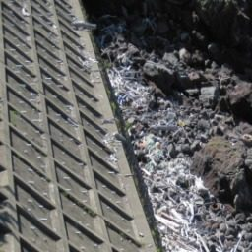
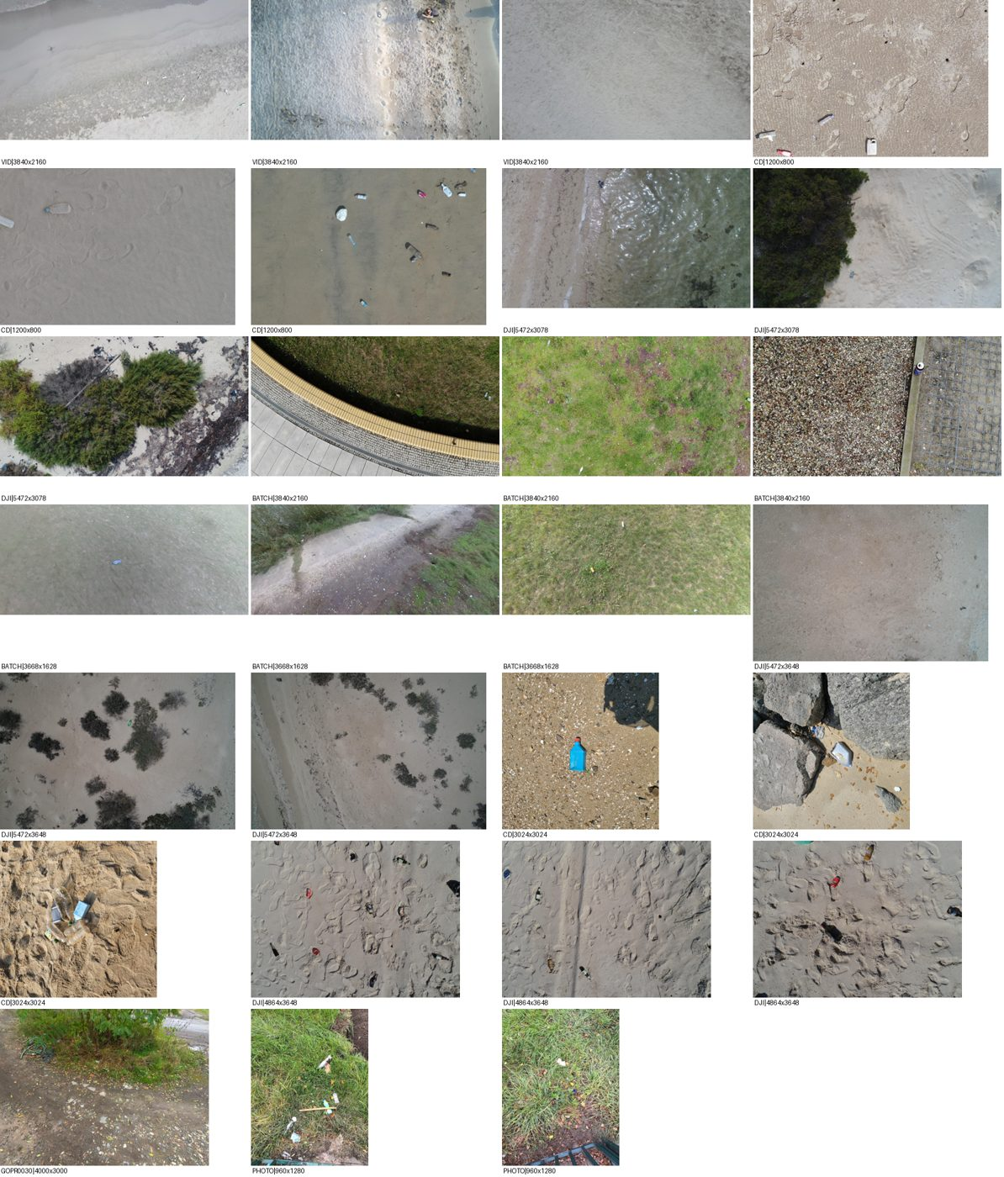

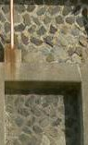

We looked at the tiles, and found problems the numbers hid
THE DATA · PROBLEMS WE HIT
Pixelated tiles
Parks in the drone set
"Is this even shore?"
Fix: no upscaling, high-quality saving, input raised from 224 to 320 px.
Fix: dropped 902 park, concrete and hand-held photos, then re-split.
Kept: sea walls are real shore backgrounds and teach what isn't debris.
Plus leakage: the drone set's official split put frames of the same video in training and test. Our video-level split removed it, and made our scores lower but honest.
G10 · Marine Debris Classification · 13
Notes:
Looking at actual tiles exposed problems no metric showed. Small beach photos came out pixelated, so we stopped upscaling and raised the input to 320 pixels. The drone set contained parks, grass and concrete floors, so we dropped 902 images by source. Some shore tiles were only sea walls; we kept those deliberately, because they are real shore backgrounds. And leakage: the drone dataset's official split shared frames of the same videos between training and test. Our video-level split fixed that, which lowers our numbers but makes them honest.

Slide 14


Four stages, each one self-contained and readable
THE CODE · STRUCTURE
prepare_data.py
Training notebooks
Evaluation notebook
Web app
Merges classes, tiles every photo, applies the label rule, makes leak-free splits, writes the tile lists.
One per model (CNN, MobileNetV2). Data loader, augmentation, model, losses and training loop, all inline.
Upload any sea photo; it tiles it like the training data and shows the model's answers.
Tunes thresholds on validation, scores the test set once: every metric, confusion matrices, ROC curves.
Keras 3 on PyTorch, native on Windows, two RTX 5060 Ti GPUs, one experiment per GPU
Every script tested end to end on small data before each real run
G10 · Marine Debris Classification · 14
Notes:
The code is four stages. The data script prepares tiles, labels and splits once. Each model has its own training notebook with all code inline, so each can be read on its own. The evaluation notebook tunes thresholds on validation and touches the test set once. And a small web app lets anyone upload a photo. The stack is Keras 3 on the PyTorch backend, running natively on Windows on two RTX 5060 Ti GPUs, and every script was tested on small data before each real run.

Slide 15
Three short pieces carry the design
THE CODE · THE PARTS THAT MATTER
A head with a trash neuron
Loss masking
The satellite lever
for u in units:
h = HEAD_OF[source]
if no_gain_for(8):
x = Dense(u, "selu")(x)
weight[h][i] = 1.0
restore(best_weights)
x = AlphaDropout(d)(x)
# every other head: 0
frozen.add("satellite")
out[name] = Dense(n,
for c in labels:
# after every batch:
"sigmoid")(x)
y[h][i, idx[c]] = 1
if frozen:
out[name+"_trash"] =
y[h+"_trash"][i] =
pin(best_weights)
Dense(1, "sigmoid")(x)
any(labels)
Stops the overfitting head while the others keep learning.
The class outputs and the trash neuron share the head's last layer.
An image only teaches its own head; the others get weight 0.
G10 · Marine Debris Classification · 15
Notes:
Three pieces of code carry the design. First, each head is a stack of SELU layers with AlphaDropout, ending in sigmoid class outputs plus one trash neuron on the same last layer. Second, loss masking: each image sets weight 1 only for its own head, so an underwater photo never teaches the shore head. Third, the satellite lever: if the satellite head's validation score doesn't improve for 8 epochs, its best weights are restored and pinned after every batch, while the other heads keep training. We first tried switching layers to non-trainable mid-training, which crashed the optimizer; masking and pinning gave the same effect safely.

Slide 16
Training, and what it taught us
PART 3
Three training rounds. Each one exposed a problem, and each fix led straight to the next question.
Notes:
Part three: training. We trained in three rounds. Every round revealed a problem, and the fix for each one set up the next question. This is the honest story, including the wins that turned out not to be wins.

Slide 17
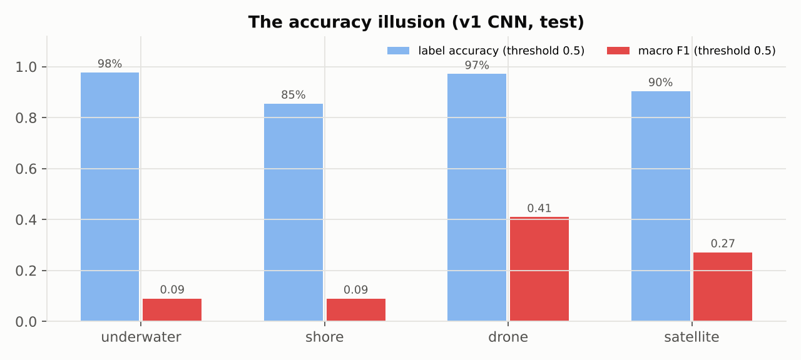
“We hit the target”: high accuracy hid weak decisions
ROUND 1 · FIRST RESULTS
99.6%
viewpoint accuracy
15%
underwater F1, the real quality of its yes/no answers
If a class is in 1.4% of tiles, always saying “no” is 98.6% accurate with F1 = 0. From here on we judged by F1 and ROC-AUC.
G10 · Marine Debris Classification · 17
Notes:
Our first round looked like a success: falling losses, 99.6 percent viewpoint accuracy, per-label accuracy between 85 and 98 percent. But F1, which only counts how good the yes answers are, was 15 percent underwater. The reason is class rarity: if a debris type appears in 1.4 percent of tiles, a model that always says no is 98.6 percent accurate. That was our first false celebration, and from then on we judged models by F1 and ROC-AUC, with thresholds tuned on validation.

Slide 18
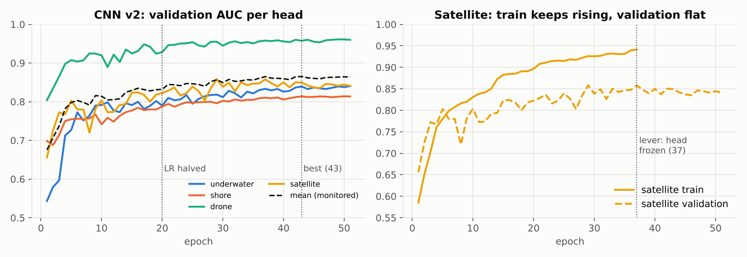
We studied the logs before changing anything
ROUND 2 · FIXES FROM THE LOGS
Shore underfit, objects tiny
Easy viewpoint loss dominated
Satellite overfit (train 95%)
→ shore tiles 3×3
→ monitor trash AUC
→ satellite lever
shore AUC 75% → 81%
checkpoints follow debris heads
gap stopped growing
G10 · Marine Debris Classification · 18
Notes:
For round two we read the logs first. Shore was underfitting with tiny objects, so we cut shore photos into 3 by 3 tiles, and shore AUC rose from 75 to 81 percent. The total loss was dominated by the easy viewpoint head, so checkpoints now follow the mean AUC of the debris heads. Satellite overfit, so we added the lever. The right chart shows it: training AUC kept climbing while validation stayed flat; once frozen at epoch 37, the gap stopped growing. Honest verdict on the lever: it stabilized satellite, it didn't raise its score.

Slide 19
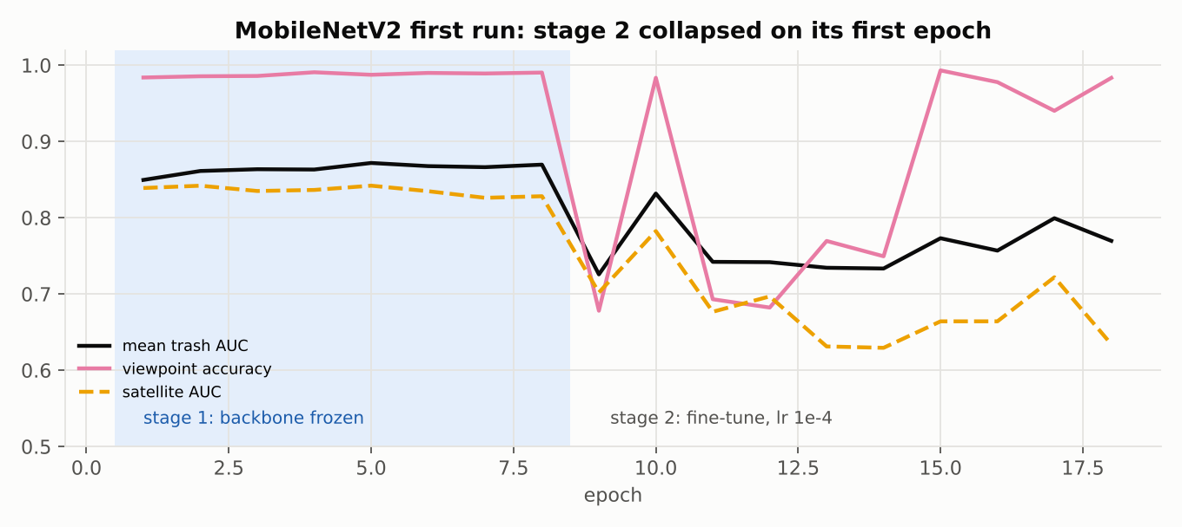
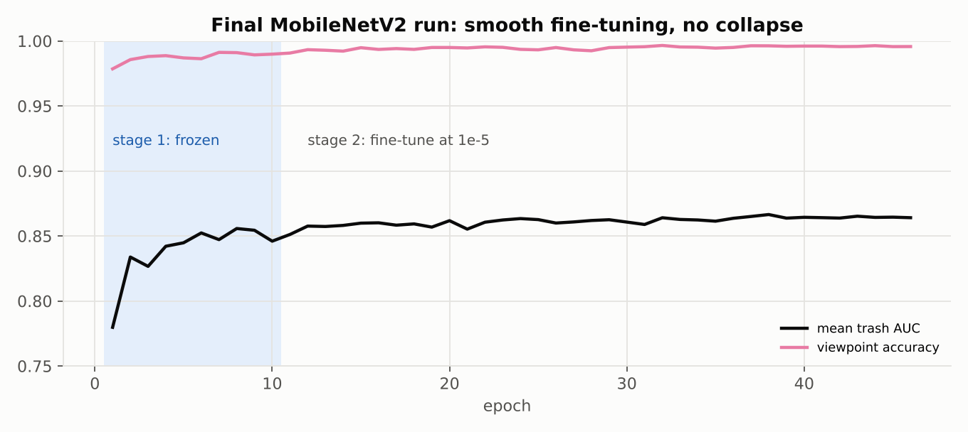
Fine-tuning collapsed once, then ran smoothly
TRANSFER LEARNING · MOBILENETV2
First try: learning rate 1e-4 wiped out the pretrained features in one epoch, and a stale frozen head made satellite worse.
The fix: learning rate 1e-5, BatchNorm kept frozen, and the satellite lever restarted when fine-tuning begins.
G10 · Marine Debris Classification · 19
Notes:
MobileNetV2 trains in two stages: first with the ImageNet backbone frozen, then fine-tuning its top blocks. Our first attempt collapsed on the first fine-tuning epoch: viewpoint accuracy fell from 99 to 68 percent. Two causes: a learning rate of 1e-4, ten times too high, and the satellite lever restoring old head weights onto a changed backbone. The fix: 1e-5, frozen BatchNorm, and a fresh lever for stage two. The right chart is the final run: smooth, with viewpoint above 99 percent throughout.

Slide 20
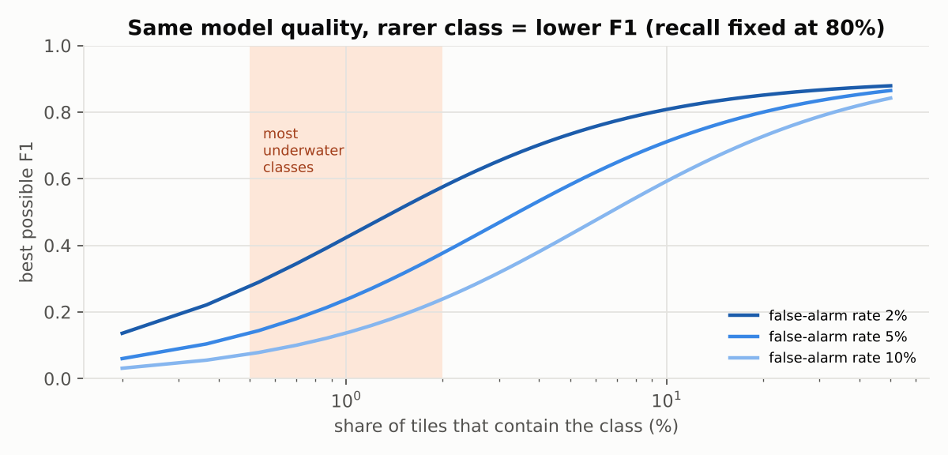
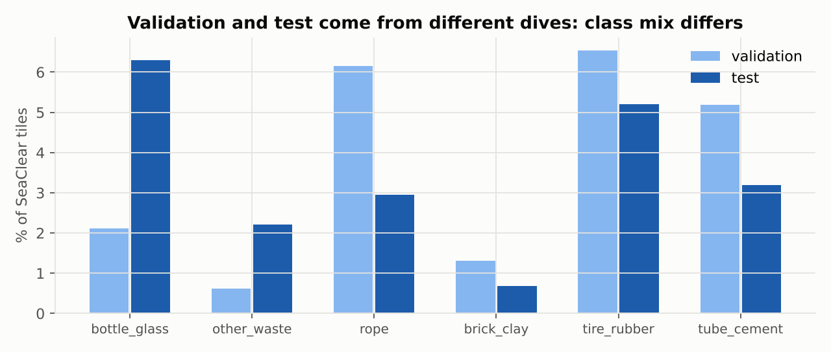
Rare classes and shifted test data capped the scores
DIAGNOSIS · WHY F1 STAYED LOW
Rarity: with 75 real cases in 7,458 tiles, even a 5% false-alarm rate means ~370 false alarms.
Shift: leak-free splits put different dives in validation and test, so tuned thresholds don't transfer.
So we asked a simpler question, “is there any trash?”, and underwater still scored close to a coin flip (62–71%). That pointed at the labels.
G10 · Marine Debris Classification · 20
Notes:
Why did F1 stay low even when ranking was decent? Two reasons. Rarity: with only 75 real cases among 7,458 tiles, a 5 percent false-alarm rate produces hundreds of false alarms. And shift: our leak-free split put different dives in validation and test, so the class mix differs and thresholds tuned on validation don't fit test. Then we tried the simplest question, trash or no trash. Drone did great, but underwater stayed near a coin flip. When two different models fail at the easiest question, you suspect the answers they learn from.

Slide 21
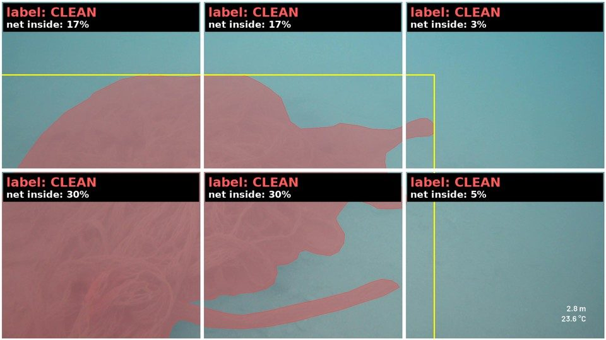
1 in 5 “clean” underwater tiles actually showed trash
THE TURNING POINT · A LABELLING BUG
19.9%
of 37,258 “clean” tiles showed a visible piece of trash
The cause was our own rule: a tile got a label only if ≥30% of the object was inside. Fine for a can; broken for big nets, ropes and tires.
The rule applied to training and test, so it taught the model wrong and graded it wrong.
A real test photo: a net (red) split into 6 tiles. Every slice is under 30% of the net, so every tile was labelled clean.
G10 · Marine Debris Classification · 21
Notes:
This is the turning point. We audited every underwater tile against the original annotations. This photo shows a net cut into our six tiles. Our rule said a tile gets the label only if at least 30 percent of the object is inside. The net is so big that each tile holds less than 30 percent of it, so all six tiles were labelled clean, including ones that are almost entirely net. Across the dataset, almost 20 percent of the tiles labelled clean actually showed trash. And because the same rule built the test set, the model was both taught wrong and graded wrong.

Slide 22
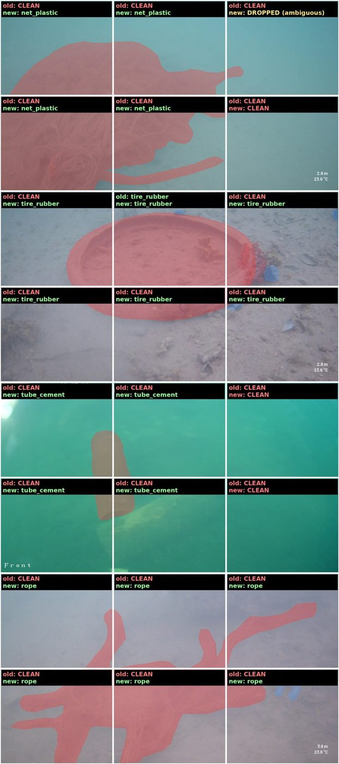
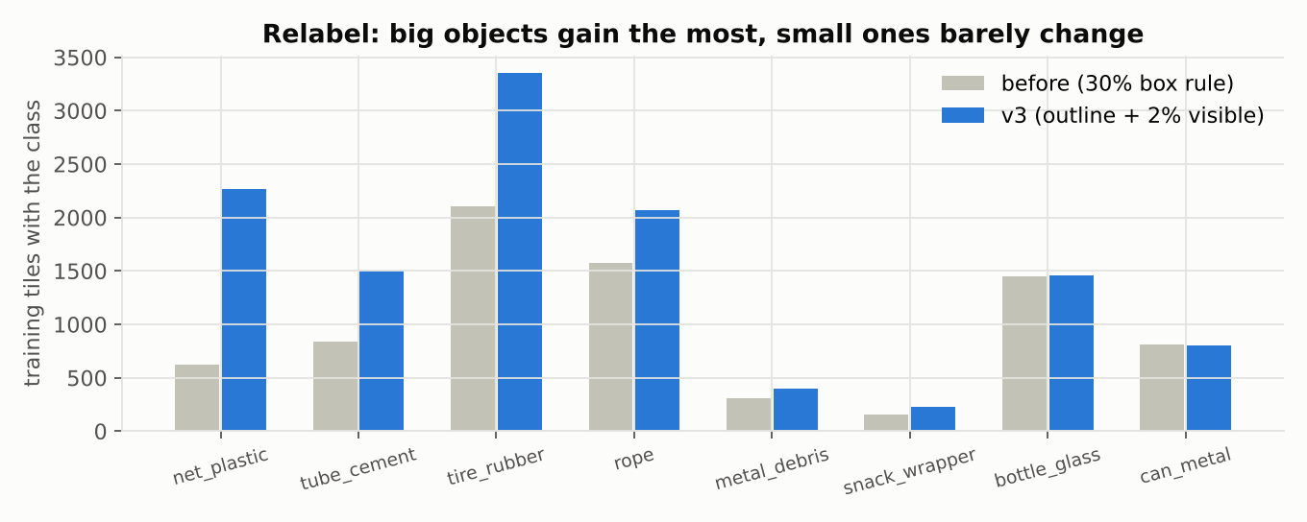
Label what is visible, measured on the real outline
THE FIX · A NEW LABELLING RULE
Outline, not box
Underwater only
Drop the unclear
Count the object's real pixels, not an empty rectangle around it.
If a clear part of the object shows, the tile is labelled. Only SeaClear needed it: its nets and ropes span many tiles.
3,219 tiles with only a sliver were left out, not guessed.
G10 · Marine Debris Classification · 22
Notes:
The fix changed only the labels, not the images or the split. First, we measure the object's real outline instead of its box. Second, if a clear part of the object is visible in a tile, the tile gets the label, even when most of the object lies in other tiles. We applied this to the underwater data only, because that is where the problem was: SeaClear has big nets and ropes that stretch across many tiles. Beach, drone and satellite labels were already fine. Third, tiles showing only a sliver are dropped rather than guessed. The left image shows old and new labels on four photos. The chart: big objects gained the most, nets went from 620 to 2,271 training tiles, while small objects barely changed. Then we retrained both models, and added a dedicated trash neuron per head.

Slide 23
Results
PART 4
Final models, corrected labels, test set used once. All numbers are percentages on photos neither model ever trained on.
Notes:
Part four: results. Everything here is on the test set with the corrected labels; thresholds were tuned on validation and the test set was used exactly once.

Slide 24
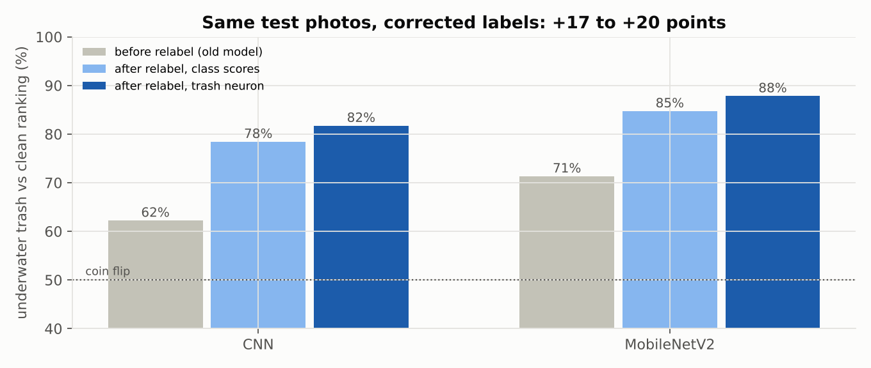
Fixing the labels was the biggest single gain
RESULTS · THE LABEL FIX
+17–20
points on underwater “is there trash?”, same test photos, before vs after
We forecast +2 to +5. The bug sat exactly on the trash-vs-clean boundary, so fixing it paid off far more.
G10 · Marine Debris Classification · 24
Notes:
The label fix, measured fairly. We re-graded the old models on the corrected test labels, so before and after use exactly the same photos and answers. Underwater trash detection: the CNN went from 62 to 82 percent, MobileNetV2 from 71 to 88. We had forecast a gain of 2 to 5 points; we got 17 to 20, because the bug sat exactly on the boundary between trash and clean. No architecture change in the project came close to this.

Slide 25
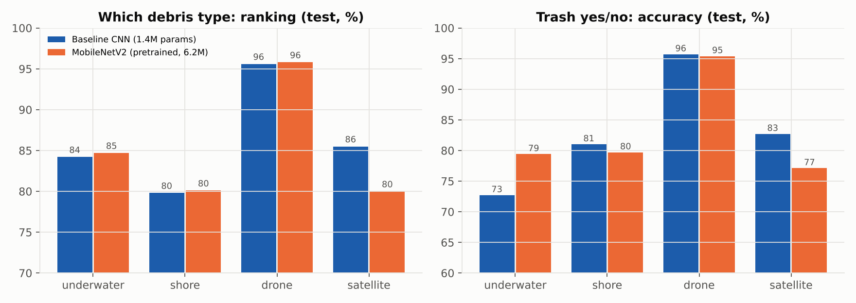
A 1.4M-parameter CNN keeps up with pretrained MobileNetV2
RESULTS · BASELINE VS TRANSFER
Underwater: MobileNetV2
Shore: tie
Drone: tie
Satellite: CNN
G10 · Marine Debris Classification · 25
Notes:
The core comparison. Blue is our baseline CNN with 1.4 million parameters, orange is MobileNetV2 with 6.2 million and ImageNet pretraining. Left: how well each ranks debris types. Right: accuracy of the trash yes or no neuron. MobileNetV2 clearly wins underwater, 79 versus 73 percent trash accuracy. Shore and drone are ties, within one or two points. And the small CNN clearly wins satellite, 83 versus 77 percent.

Slide 26
Accuracy, precision, recall, F1 and ROC-AUC, side by side
RESULTS · EVERY REQUIRED METRIC
Which debris type (class average)
Is there trash? (trash neuron)
Head | Model | Acc | Prec | Rec | F1 | AUC
Underwater | CNN | 89.7 | 18.5 | 42.2 | 21.8 | 84.2
 | MNV2 | 93.7 | 29.7 | 41.3 | 27.1 | 84.7
Shore | CNN | 82.4 | 24.2 | 52.9 | 31.5 | 79.8
 | MNV2 | 84.0 | 24.9 | 49.0 | 31.9 | 80.1
Drone | CNN | 97.7 | 61.3 | 56.3 | 58.0 | 95.6
 | MNV2 | 97.9 | 67.9 | 55.1 | 60.0 | 95.8
Satellite | CNN | 89.0 | 53.8 | 62.0 | 54.9 | 85.5
 | MNV2 | 86.9 | 46.2 | 50.2 | 45.2 | 80.0
Head | Model | Acc | Prec | Rec | F1 | AUC
Underwater | CNN | 72.7 | 60.6 | 80.3 | 69.1 | 81.7
 | MNV2 | 79.4 | 69.2 | 81.9 | 75.1 | 87.8
Shore | CNN | 81.0 | 79.5 | 94.4 | 86.3 | 90.0
 | MNV2 | 79.7 | 78.5 | 93.7 | 85.4 | 89.3
Drone | CNN | 95.7 | 87.5 | 91.3 | 89.4 | 98.7
 | MNV2 | 95.4 | 86.7 | 90.9 | 88.7 | 98.4
Satellite | CNN | 82.7 | 70.1 | 66.7 | 68.3 | 86.8
 | MNV2 | 77.1 | 59.2 | 58.3 | 58.8 | 79.8
Test set, %. Coloured: clear wins (2+ points). Viewpoint accuracy: CNN 99.5, MobileNetV2 99.6. Accuracy is high everywhere because most labels are “no”; F1 and AUC are the honest columns.
G10 · Marine Debris Classification · 26
Notes:
All the metrics the assignment asks for, for both final models on the test set. Left: debris type, averaged over each head's classes. Right: the trash neuron. Coloured cells are clear wins of two points or more: orange for MobileNetV2 on underwater, blue for the CNN on satellite. Notice how accuracy is high everywhere, 82 to 98 percent, while F1 is much lower: most labels are no. F1 and ROC-AUC are the columns to read. Viewpoint accuracy is 99.5 and 99.6 percent.

Slide 27
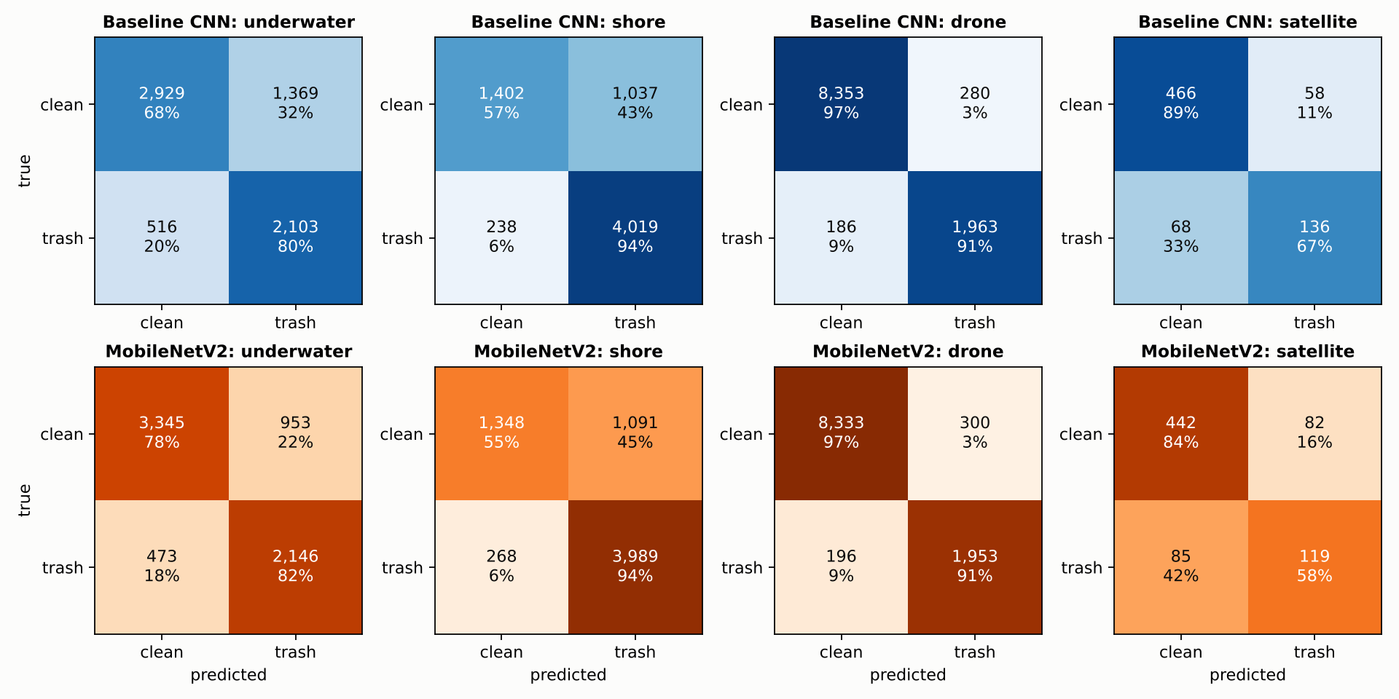
Where each model is right, and where it raises false alarms
RESULTS · CONFUSION MATRICES
Drone: 91% of trash tiles found, 97% of clean tiles correct, for both models.
Underwater: MobileNetV2 raises 953 false alarms vs the CNN's 1,369. That is its whole lead.
Satellite: the CNN finds 67% of pollution vs 58%.
G10 · Marine Debris Classification · 27
Notes:
The trash-neuron confusion matrices: top row the CNN, bottom row MobileNetV2, one column per viewpoint, with counts and the share of each true class. Drone is near perfect for both. Underwater, MobileNetV2's advantage is fewer false alarms: 953 against 1,369. On satellite, the CNN finds two thirds of the pollution patches against 58 percent.

Slide 28
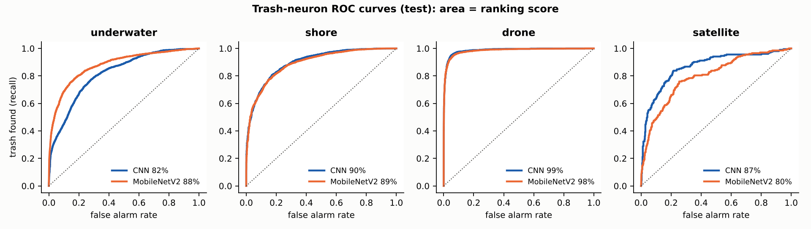
The curves overlap everywhere except underwater and satellite
RESULTS · ROC CURVES
88% vs 82%
90% · 99%
87% vs 80%
underwater area, MobileNetV2 vs CNN
shore · drone, both models
satellite area, CNN vs MobileNetV2
G10 · Marine Debris Classification · 28
Notes:
ROC curves show ranking quality independent of any threshold; the area under each curve is the ROC-AUC. On shore and drone the two models are indistinguishable, at 90 and 99 percent. MobileNetV2 sits higher underwater, 88 against 82, and the CNN sits higher on satellite, 87 against 80.

Slide 29
The limits come from the data, not from the build
THE VERDICT
+17–20
3 of 4
96%
points from fixing labels. Extra training gave about +1; swapping the whole backbone changed 0–7.
viewpoints where our 1.4M-parameter CNN wins or ties against a pretrained network 4× its size.
drone trash detection accuracy. Viewpoint is 99.5%. Rare debris types stay hard for both models.
Transfer learning pays off where test images look like its pretraining photos (underwater). On satellite images, unlike anything in ImageNet, the model built for the task wins.
G10 · Marine Debris Classification · 29
Notes:
Our verdict. First, the limits are in the data, not the build: fixing labels gave 17 to 20 points, while extra training gave about one and swapping the backbone at most seven. Second, a small CNN designed for the task wins or ties on three of four viewpoints against a pretrained model four times its size. Third, the system is genuinely useful for coarse questions: 96 percent drone trash detection, 99.5 percent viewpoint. Transfer learning helps most where the images resemble its pretraining, underwater; on satellite imagery the task-built model wins.

Slide 30
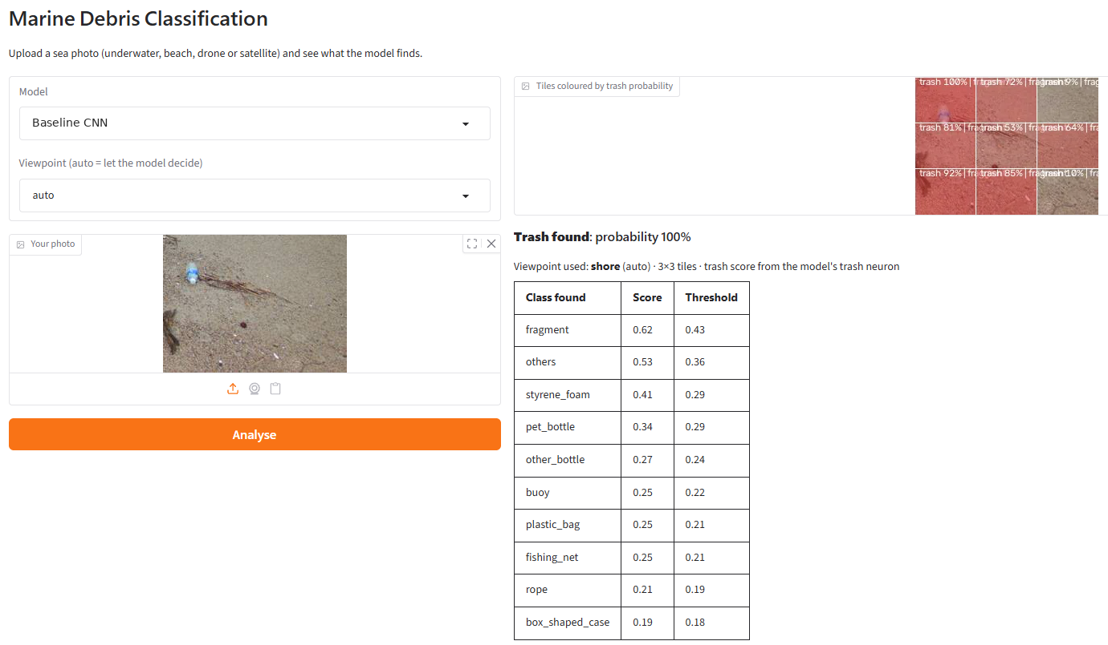
Upload any sea photo and watch the model read it
LIVE DEMO
1
Pick a model and upload a photo
2
The model names the viewpoint
3
The photo is tiled like the training data
4
Each tile is tinted by its trash probability
5
Detected debris types are listed with scores
G10 · Marine Debris Classification · 30
Notes:
We built a small web app around the trained models. You pick a model, upload any sea photo, and it names the viewpoint, tiles the photo exactly like the training data, tints each tile by its trash probability, and lists the debris types that pass their validation-tuned thresholds. Here, a beach photo with a plastic bottle: the model picks the shore viewpoint, finds trash, tints the tiles around the bottle red, and lists fragment, styrene foam and PET bottle among the classes. In our own tests the predictions looked right; that is a qualitative check, not a measured score. Live demo here if time allows.

Slide 31
What still limits the model, and what we would do next
LIMITS AND FUTURE WORK
Limits
Next steps
Rare debris types: few independent examples, many frames of the same videos
Animals and robot parts still score like trash underwater
Validation and test come from different dives, so thresholds drift
Only tested on photos from the four datasets
Train a detector on the original boxes instead of converting to tiles
More sites and dives, not more frames
Explicit "animal" and "robot" examples as hard negatives
Broader classes where examples are scarce; a labelled outside test set
G10 · Marine Debris Classification · 31
Notes:
The honest limits: rare debris types have too few independent examples; underwater, both models still treat animals and robot parts as trash; validation and test come from different dives; and everything was measured on the four datasets' own photos. Next steps: train a detector on the original boxes, collect more diverse sites rather than more frames, add hard negatives for animals and robot parts, merge scarce classes, and build a labelled outside test set to measure real-world performance.

Slide 32
REFERENCES
Đuraš A., Wolf B.J., Ilioudi A., Palunko I., De Schutter B. (2024). A dataset for detection and segmentation of underwater marine debris in shallow waters. Scientific Data 11, 921.
He Y., Yin W., Zhou S., Shan S., Jiang X. (2025). Subaquatic garbage recognition based on improved YOLOv11 network. Preprints.org, 202508.0676.
Hidaka M., Murakami K., Kawahara S., Sugiyama D., Nakagawa Y., Kako S., Matsuoka D. (2023). BePLi Dataset v2: Beach Plastic Litter Dataset version 2. SEANOE. doi:10.17882/96963
Jack P., Biggs T., Sousa D., Coulter L., Hutmacher S., McMillan H. (2025). Multi-resolution UAV remote sensing for anthropogenic debris detection in complex river environments. Remote Sensing 17(13), 2172.
Kikaki K., Kakogeorgiou I., Hoteit I., Karantzalos K. (2024). Detecting marine pollutants and sea surface features with deep learning in Sentinel-2 imagery. ISPRS J. Photogramm. Remote Sens. 210, 39–54.
Kataria S. (2025). Domain-robust marine plastic detection using vision models. arXiv:2510.03294.
Sandler M. et al. (2018). MobileNetV2: inverted residuals and linear bottlenecks. CVPR.
UCWD v1: coastal waste drone imagery, COCO export (dataset page).
Manesis J., Mikeli P., Kikaki K., Kakogeorgiou I., Karmas A., Karantzalos K. (2026). Detecting marine pollutants using Sentinel-1 SAR and Sentinel-2 optical imagery. ISPRS Annals XI-3-2026, 187–192.
Lin T.-Y. et al. (2017). Focal loss for dense object detection. ICCV.
Smith S.L. et al. (2018). Don’t decay the learning rate, increase the batch size. ICLR.
G10 · Marine Debris Classification · 32
Notes:
References: the four dataset sources, the 2025 and 2026 related work from the literature slide, and the three method papers behind MobileNetV2, focal loss and the batch-size warm-up.

Slide 33
Thank you
Questions are welcome, about the design, the data, the bug, or the numbers.
Adham Yakout · Adham Elbehiry · Asma Raafat · Hamza
Notes:
Thank you. We're happy to take questions on any part: the design choices, the data, the labelling bug or the results.

